Slide 1
BNY
Corporate Action Intelligence
Mid-Semester Progress
Bank of New York
Aesha Gandhi, Pranshul Bhatnagar, Alex Li, Kedar Vaidya, Aaron Jiang
Notes:
Hi everyone, we're the Corporate Action Intelligence team, and we're working with BNY's AI Hub.
The question we're tackling is whether AI can read the long, messy filings behind corporate actions and turn them into structured records that people can actually trust. This is where we are at the middle of the semester.

Slide 2






What we'll cover today
01
02
03
04
05
06
The problem
Our approach
How it works
Data + evaluation
Live demo
What's next
Notes:
Here's our plan for today. We'll start with the problem, then how we approached it, how our pipeline works, how we build our data and evaluate it, then a live demo, and finally what's next.
If you remember one thing from today, it's this: every value we pull out of a filing links back to the exact text it came from. That traceability is what makes this useful for a bank.

Slide 3



BNY sits between companies and the investors who own their shares
Corporate actions
Alerts
mergers, buyout offers …
what changes, what to do, by when
Companies
BNY, the custodian
Clients
Issue shares and announce events
Holds clients' shares and services them
Pension funds, asset managers, insurers
Notes:
Its core business is being a custodian. Large investors like pension funds, asset managers and insurers don't hold their shares themselves. BNY holds them and services them on their behalf, across more than 50 trillion dollars of client assets.
So BNY sits in the middle. Companies issue shares and announce events, like a merger or an offer to buy shares. Those events are called corporate actions. BNY has to understand each one and alert every client who holds that share: what's changing, what they need to do, and by when.
If a filing is misread, a client can miss a deadline or be paid the wrong amount, and BNY is responsible for making that right. That's the work we're trying to make faster and more reliable.

Slide 4
When a company changes its shares, every holder must be told
1
2
3
4
Company announces
Files with the SEC
BNY reads the filing
Clients are alerted
Bending Spoons buys Eventbrite at $4.50 / share
An 816K-character proxy statement
Staff pull out price, dates and options
Every Eventbrite holder is notified
We automate this step
Five corporate-action types in scope
Merger
Tender offer
Exchange offer
Rights issue
Conversion
One company absorbs another
Buyer bids for shares directly
Swap old securities for new
Holders may buy new shares
Bonds turn into stock
Notes:
Here's what that looks like for one real corporate action.
Bending Spoons agreed to buy Eventbrite for $4.50 in cash per share. That deal was filed with the SEC in a proxy statement of about 816,000 characters. Because BNY holds Eventbrite shares for its clients, someone has to read that filing and pull out the price, the dates and the options. Then every client holding Eventbrite gets an alert.
That third step, reading the filing, is done by hand today, and it's the step we're automating.
We're covering five types of corporate actions: mergers, tender offers, exchange offers, rights issues and conversions.

Slide 5
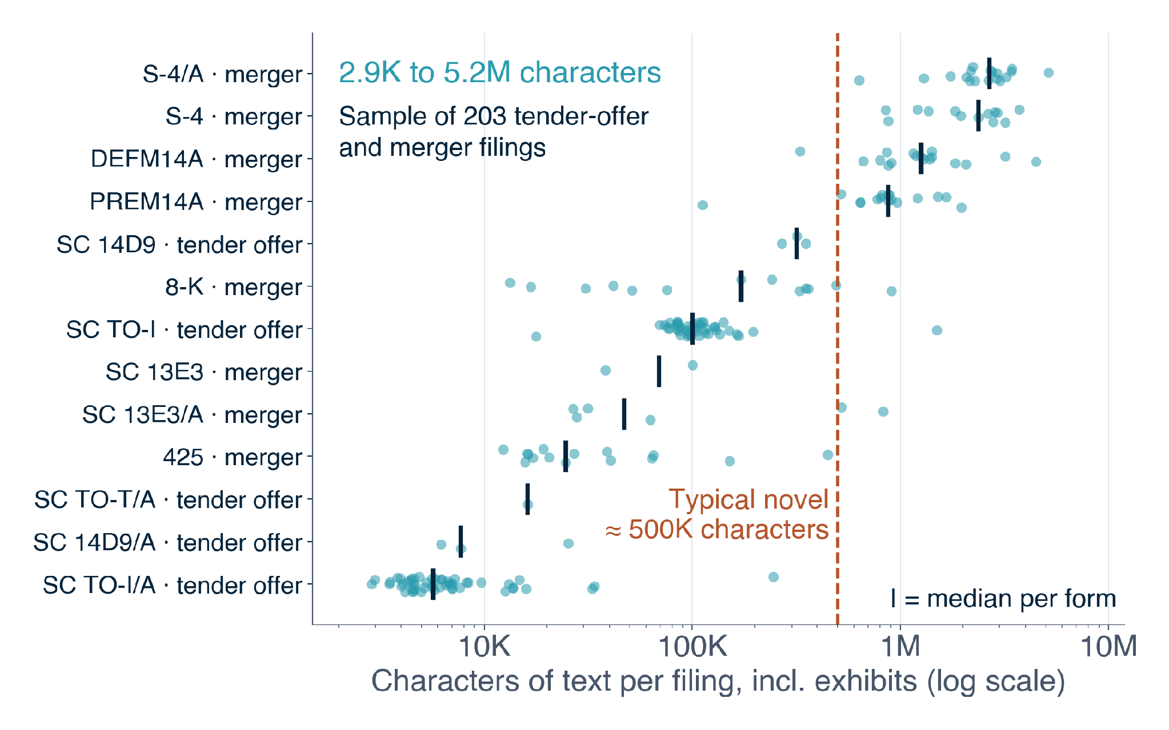
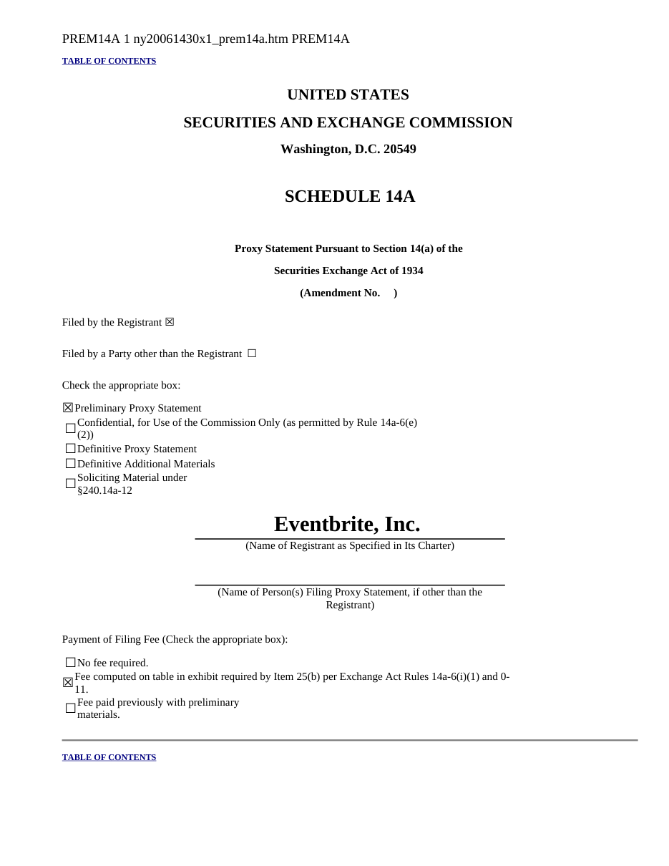
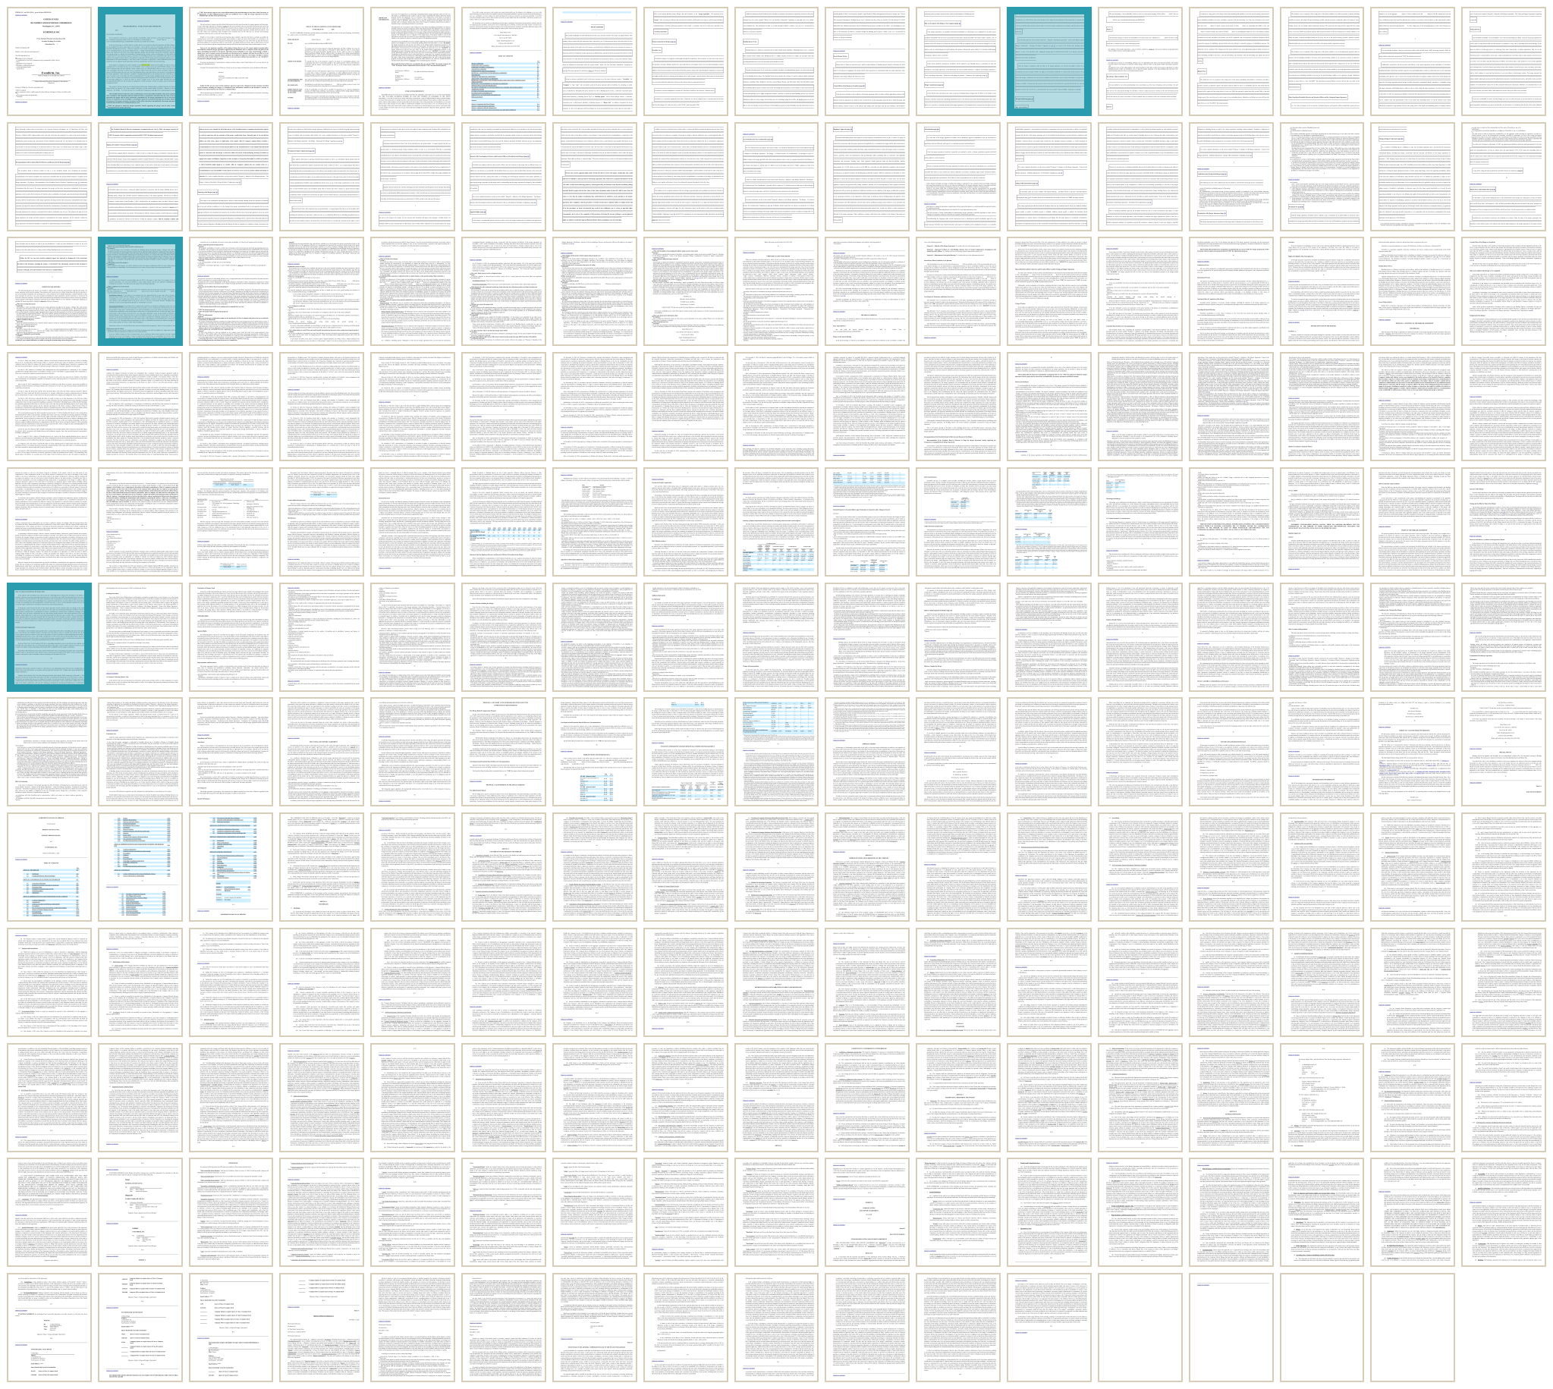
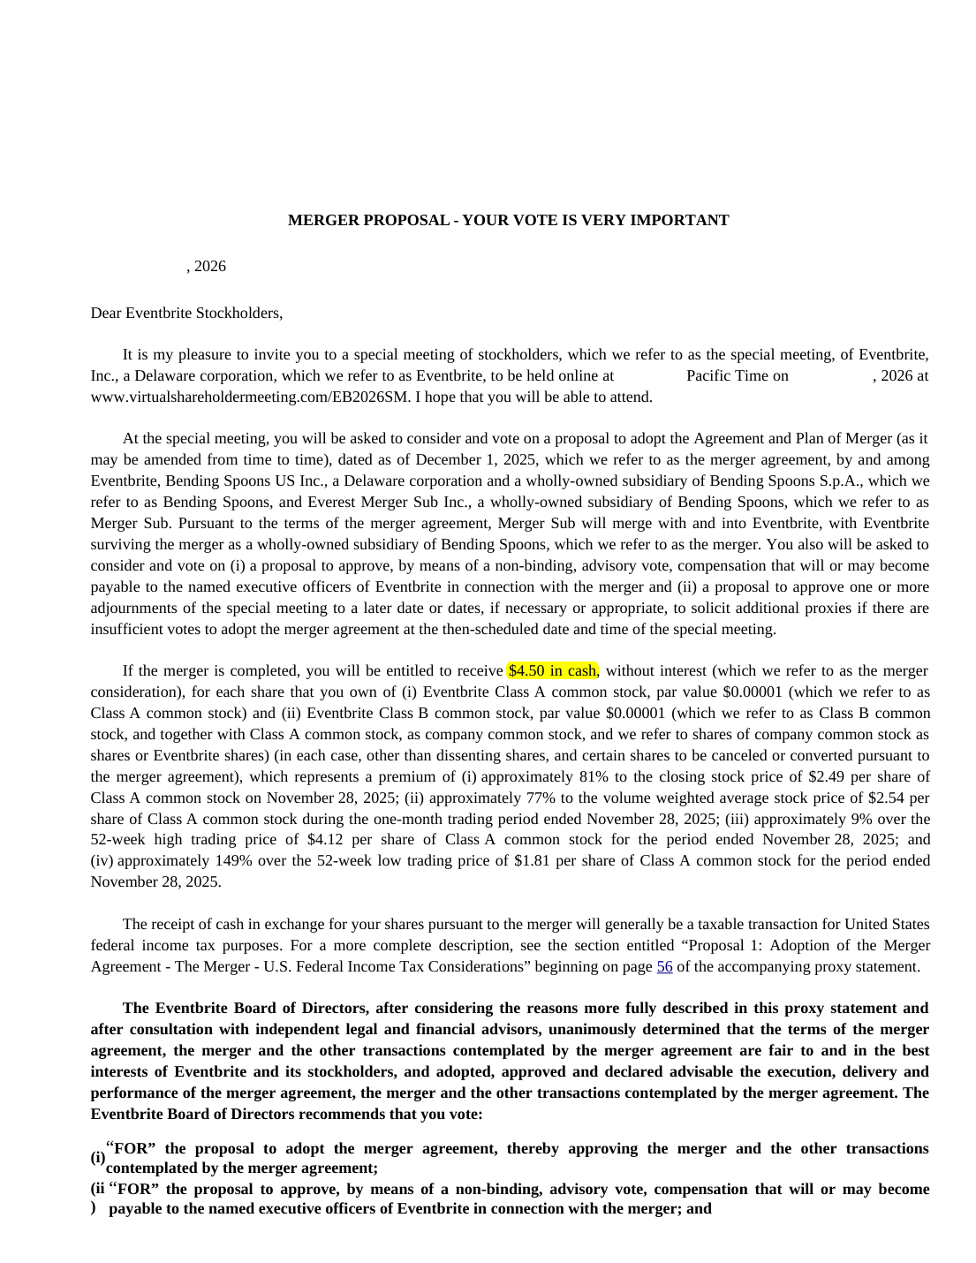
Corporate-action filings can run longer than a novel
ONE REAL FILING Eventbrite merger proxy statement (PREM14A)
Why it is hard
Long
Terms buried in tables, footnotes and annexes
Changing
Amendments revise prices and dates
Ambiguous
Is "$0.01" the offer, a par value or an old bid?
~200 pages
Notes:
So why is reading the filing hard?
This is that same Eventbrite filing. It's about 200 pages long, and the one number a client cares about most, the $4.50 cash price, shows up on only four of those pages.
And that's not unusual. Each dot here is one filing from our sample of tender-offer and merger filings. They range from a few thousand characters to over five million, which is roughly ten novels.
On top of being long, the information changes, because amendments revise prices and dates after the first filing. And it's ambiguous: a dollar figure could be the offer price, a par value, or an old bid that was rejected.

Slide 6


We broke the problem into four connected parts
Data
Extraction
Evaluation
Value
THE GOAL
Structured records of every corporate action
Which filings, and their full text?
Which values, and where?
Is each value right?
What does BNY gain?
HOW WE TACKLE IT
HOW WE TACKLE IT
HOW WE TACKLE IT
HOW WE TACKLE IT
Search and load SEC filings for all 5 types
Pull each value with the quote behind it
Compare against a reference set from the same filings
Turn records into alerts and measure the payoff
Notes:
We broke the problem into four connected parts.
First, data: which filings matter, and how do we get their full text? We search and load SEC filings for all five types.
Second, extraction: which values do we need, and where are they? We pull out each value along with the quote that supports it.
Third, evaluation: how do we know each value is right? We compare against a reference set built from the same filings.
And fourth, value: what does BNY actually gain? We turn the records into alerts and measure the payoff.
All four lead to one goal: a structured record of every corporate action, where each value is backed by a quote from the filing. BNY can't share client data with us, so we work only from public SEC filings, and anything only BNY would know, like client accounts and positions, stays blank rather than being guessed.

Slide 7
Our pipeline turns raw filings into one verified record per event
SEC
search
Download
bundle
Clean
text
Extract
candidates
Concise
record
Reason +
verify
Canonical
event
Client
alert
Ingest
Extract
Resolve
Deliver
get the full text
values + quotes
one record per event
alert clients
Example: the Eventbrite merger
RAW FILING
CANDIDATE
EVENT RECORD
CLIENT ALERT
816K characters of HTML
"$4.50 in cash … for each share"
Cash · USD 4.50 · Pending
"Eventbrite: $4.50 cash merger"
Built
Next
Prototype
Notes:
Here's that idea as a pipeline. It has eight steps in four phases: ingest, extract, resolve and deliver.
The teal steps are built and running on real filings. We search the SEC, download each filing and its exhibits, clean it into readable text, extract candidate values, and build a compact record. The grey steps come next: reasoning across a filing and its amendments so we end up with one current record per event. The client alert at the end is a prototype, which you'll see in the demo.
Along the bottom is the Eventbrite example flowing through it: from the raw filing, to the "$4.50 in cash" candidate, to a structured event record, to a client alert.

Slide 8
Each extraction method fails differently, so we combine them
Keyword rules
GLiNER
LLM
Human review
1
2
3
4
pattern matching
small entity model
large language model
team members
GOOD AT
GOOD AT
GOOD AT
GOOD AT
Exact formats, e.g. CUSIP check digits
Fast, runs locally, exact text spans
Reads context and complex terms
The ground truth
STRUGGLES WITH
STRUGGLES WITH
STRUGGLES WITH
STRUGGLES WITH
9,299 "$" matches, only 354 deal terms
Picks headings ("Offer Price") over values
Slow; the longest filings time out
Does not scale to thousands of filings
Validate IDs
Propose candidates
Reason + reference set
Verify a sample
Cheaper · faster · more literal
Costlier · slower · understands context
Notes:
The extraction step is where our method choices matter, and we found that each method fails in a different way.
Keyword rules are precise for fixed formats, like checking that a CUSIP identifier is valid, but they're very literal. In 35 merger filings, 9,299 dollar amounts matched our pattern, and only 354 of them were actual deal terms.
GLiNER, a small entity-recognition model, is fast and runs on our own machines, but it often grabbed a heading like "Offer Price" instead of the actual price.
A large language model understands context and complex terms really well, but it's slow, and the very longest filings can time out.
And human review is the ground truth, but people can't read thousands of filings.
So we combine them, and let each one do the job it's best at. Moving from left to right, the methods get more expensive and slower, but understand more context.

Slide 9
No labelled data exists, so we build our own from SEC filings
Search
SEC filings by form, keyword and date, for all 5 action types
Download
Each filing plus its exhibits, cleaned into readable text
Label
An LLM pulls each field with the quote behind it: 571 records so far
Notes:
All of this needs data, and there's no labelled dataset for this task. Nobody publishes corporate-action filings with the answers filled in, and BNY can't share theirs. So we built our own from public SEC filings, in three steps.
First, we search the SEC by form type, keyword and date, for all five action types. Second, we download each filing along with its exhibits and clean it into readable text. Third, we use a large language model to pull out each field together with the exact quote that supports it, and we have 571 of those labelled records so far.
That labelled set becomes the reference we score our own pipeline against.

Slide 10
Every extracted value carries the exact quote that supports it
FROM THE FILING
STRUCTURED RECORD
Eventbrite proxy statement, letter to stockholders
Acquirer
Bending Spoons US Inc.
5 / 5
Target
Eventbrite, Inc.
5 / 5
"If the merger is completed, you will be entitled to receive $4.50 in cash … for each share that you own…"
Consideration
Cash
5 / 5
Cash per share
USD 4.50
5 / 5
Status
Pending
5 / 5
Holder choice
None
5 / 5
+ 2 more supporting quotes for this record
5 / 5 = quote directly supports the value
Notes:
Here's what one of those records looks like.
On the left is the actual sentence from Eventbrite's letter to its stockholders, saying holders will receive $4.50 in cash for each share. On the right is the structured record we built from it: the acquirer, the target, the type of payment, the cash per share, the deal status, and whether holders get a choice.
Every value comes with the quote behind it and a score from one to five for how directly that quote supports it. So instead of searching a 200-page document, a reviewer can check each value in seconds.

Slide 11
We aim for LLM-level accuracy at lower cost, and check it two ways
1
BEFORE DEPLOYMENT benchmark
The goal
LLM-level accuracy at a fraction of the cost
SEC filings
LLM reference set
Our pipeline
Compare field by field
Accuracy
sampled across forms
+ human spot checks
rules + GLiNER learn from it
accuracy · completeness
Our target
LLM reads
every filing
2
AFTER DEPLOYMENT continuous checks
Pipeline today
Live outputs
Stratified sample
Backward LLM check
Confidence score
new filings as they arrive
across event + filing types
"Is this value in the filing?"
low → human review
Cost + latency
Notes:
So how do we know the values are right?
Our goal is on the right. Having a large language model read every filing gives good accuracy, but at BNY's scale it's expensive and slow. We want to reach that same level of accuracy at a fraction of the cost. This chart is illustrative, not measured.
We check it in two ways. Before deployment, a language model builds a reference set from the filings, and we spot-check it by hand. Our cheaper pipeline, using rules and GLiNER, learns from that set, and we score it field by field.
After deployment, we take a sample of the live results across different event and filing types and run what we call a backward check. Instead of re-reading the whole filing, we just ask whether the filing actually supports each value we extracted, which is much cheaper. That gives every value a confidence score, and anything with low confidence goes to a person to review. That last part came directly from BNY's feedback: reviewers want to know how closely they need to look.
Let us show you what this looks like in practice.

Slide 12
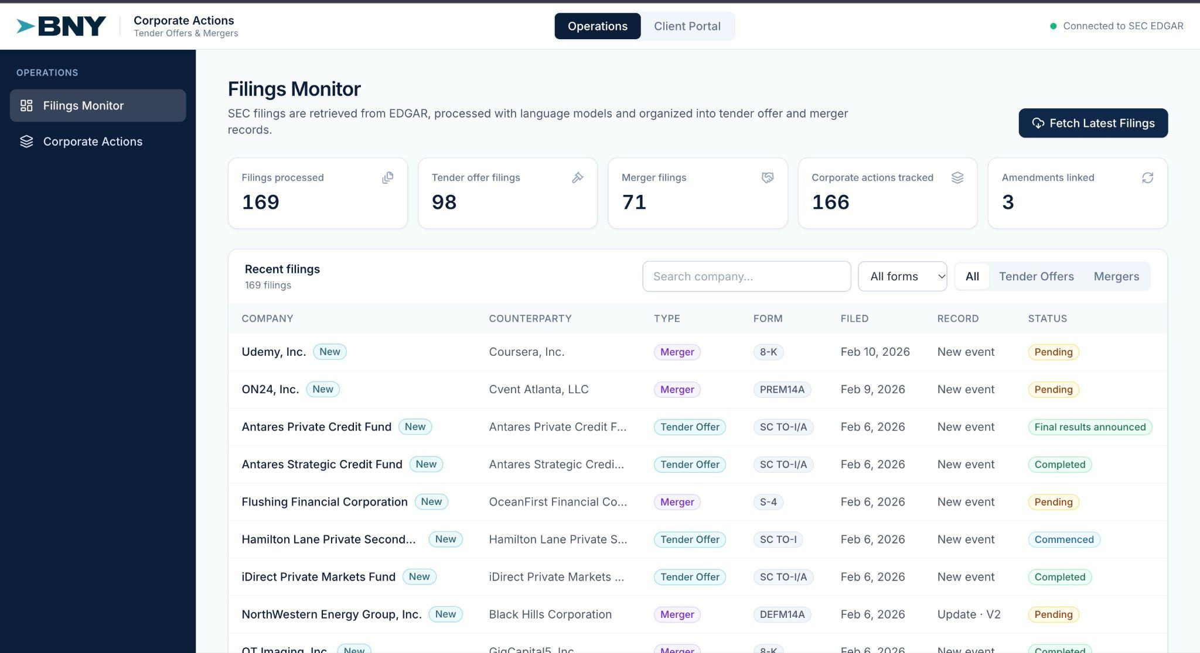
Demo: extracted records power a filings monitor and client alerts
Notes:
This is our filings monitor. It lists every SEC filing we've processed, with its type, form and status.
When we fetch the latest filings, the system connects to the SEC, finds new filings, downloads them, extracts the terms, links them to existing events, and stores the results.
If we open a merger record, you can see the extracted terms: the parties, the consideration, the conditions and the dates, along with the passage from the filing that each value came from.
This is the version history. When an amendment comes in, the record updates, and you can see exactly what changed. And from here we can always click through to the original filing on the SEC's website, so a person can check the source.
Finally, this is the client side. A client can add a company to their watchlist and get notified whenever there's news on it.
That's where we are today. Here's what we can't claim yet.

Slide 13
Four limitations bound what we can claim today
1
No independent ground truth
2
Only part of the scope is built
Next: human review of a sample
Next: all five types
3
A filing is not an event
4
Limited view of BNY's process
Next: event tracking
Next: check with BNY experts
Notes:
We want to be upfront about four limitations.
First, we don't have an independent ground truth yet. Our reference set is made by a language model, and nobody has checked it by hand. Next, people will review a sample of the records against the filings.
Second, only part of the scope is built. Two of the five action types have labelled data, tender offers and mergers, and our GLiNER extraction pipeline currently only handles tender offers. Next, we'll extend both to all five types.
Third, a filing is not the same as an event. One deal shows up across many filings and amendments, and we don't link them together yet. That's what event tracking will solve.
And fourth, we have a limited view of BNY's own process. Their internal workflows and data are proprietary, so we can't see exactly how their teams handle corporate actions today. We design from public filings and their feedback, and we'll keep checking our assumptions with BNY's subject matter experts as we build.

Slide 14



Next: verify, track events over time, and build downstream tasks
Verify + expand
Track each event over time
Build downstream tasks
Human review of the reference set
Client notification drafts
Original filing
Amendment 1
Amendment 2
Add exchange, rights, conversion
Change alerts on amendments
Event history: current terms + every change
OPTIONS WE ARE EXPLORING
Screen out non-events
Exception queue for review
RAG
Hindsight
retrieve earlier filings
agent memory of state
Notes:
Looking ahead, we have three directions, and the scope will keep evolving with BNY's feedback.
First, verify and expand: reviewing the reference set by hand, adding exchange offers, rights issues and conversions, and screening out filings that aren't real events.
Second, tracking each event over time. The original filing and every amendment should feed one event history that always shows the current terms and everything that changed. We're exploring two ways to do this: RAG, which retrieves an event's earlier filings whenever a new one arrives, and Hindsight, an agent memory that keeps track of each event's current state.
Third, building the downstream tasks BNY actually uses: drafting client notifications, sending alerts when an amendment changes the terms, and a queue of uncertain cases for people to review.

Slide 15

What BNY gets: reusable, auditable tools, not a one-off model
Reference dataset
2 of 5 types
SEC loader
Extraction pipeline
Built
Every value
traceable to
its source
Tender built
ROI model
Evaluation harness
Framework v1
Designed
Notes:
So what does BNY actually get from this?
Not a one-off model, but a set of reusable tools. The SEC loader is built. The reference dataset covers two of the five types so far. The extraction pipeline is built for tender offers. The evaluation setup is designed. And the ROI model has its framework in place.
What ties them all together is that every value can be traced back to its source. That's what a bank needs before it can trust automation.

Slide 16

Questions?
Thank you. We are happy to take questions.
Corporate Action Intelligence Team
Aesha Gandhi, Pranshul Bhatnagar, Alex Li, Kedar Vaidya, Aaron Jiang
Notes:
Thank you so much for listening. We'd love to take your questions.
Why not just use ChatGPT on every filing? It actually works fairly well, but at BNY's volume it's expensive and slow, it can make things up, and it's hard to audit. We use the language model to teach and check a cheaper pipeline instead.
How accurate is it? We don't have an accuracy number yet. Reviewing a sample by hand is our next step, and our evaluation setup is built to measure exactly that.
Why only public SEC data? BNY can't share client data, so anything only BNY would know stays blank rather than guessed.
How do you handle amendments? Right now each filing is its own record. Linking filings into one event history is our next major step.
What happens when the system isn't sure? Every value gets a confidence score, and low-confidence values go to a person.
What about dates? BNY told us dates like record dates, election deadlines and payment dates are the most critical fields, because a wrong deadline is the costliest mistake. Adding them is a current priority.

Slide 17
Appendix: does the build pay for itself within five years?
Our formula-first ROI framework. Inputs are placeholders until confirmed with BNY.
Benefits
Costs
Outputs
Released hours
Hours freed × cost per FTE × realisation rate, from automating some events fully and shortening review on the rest
Avoided errors
Annual error cost × share caused by data sourcing × share the AI removes
Build and integration
One-time, in year 0
Run and maintenance
Yearly, as a share of the build cost
AI processing
Per event; grows with adoption
Governance and platform
Yearly model-risk, oversight and platform
Yearly net
years 1–5
Payback
Years until savings cover the build
ROI on upfront investment
Net benefit earned on the build, 5-year and per year
Break-even build cost
The most the build could cost and still pay off
NPV and IRR
Value in today's dollars and the equivalent annual return
−
=
Decision test: five years of net benefit, valued in today's dollars, must cover the year-0 build (NPV ≥ 0).
Notes:
This appendix slide summarizes our ROI framework. It isn't part of the talk, but it's here if anyone asks whether the project is worth building.
The question is simple: if BNY spends once to build this in year zero, do the savings over the next five years justify it? Each year's net is benefits minus costs.
Benefits come from two places. Released hours, from fully automating some manual events and shortening review time on the rest, valued at the cost of an operations employee and a realisation rate. And avoided errors: the share of today's error cost that comes from data sourcing, times the share the system removes.
Costs have four lines: the one-time build, yearly run and maintenance, a per-event AI processing cost, and governance and platform costs.
From that yearly net we report payback, ROI on the upfront investment, the break-even build cost, and NPV and IRR. The decision test is that five years of net benefit, in today's dollars, covers the build. The inputs are placeholders until BNY confirms their volumes and costs.

Slide 18
Appendix

Slide 19
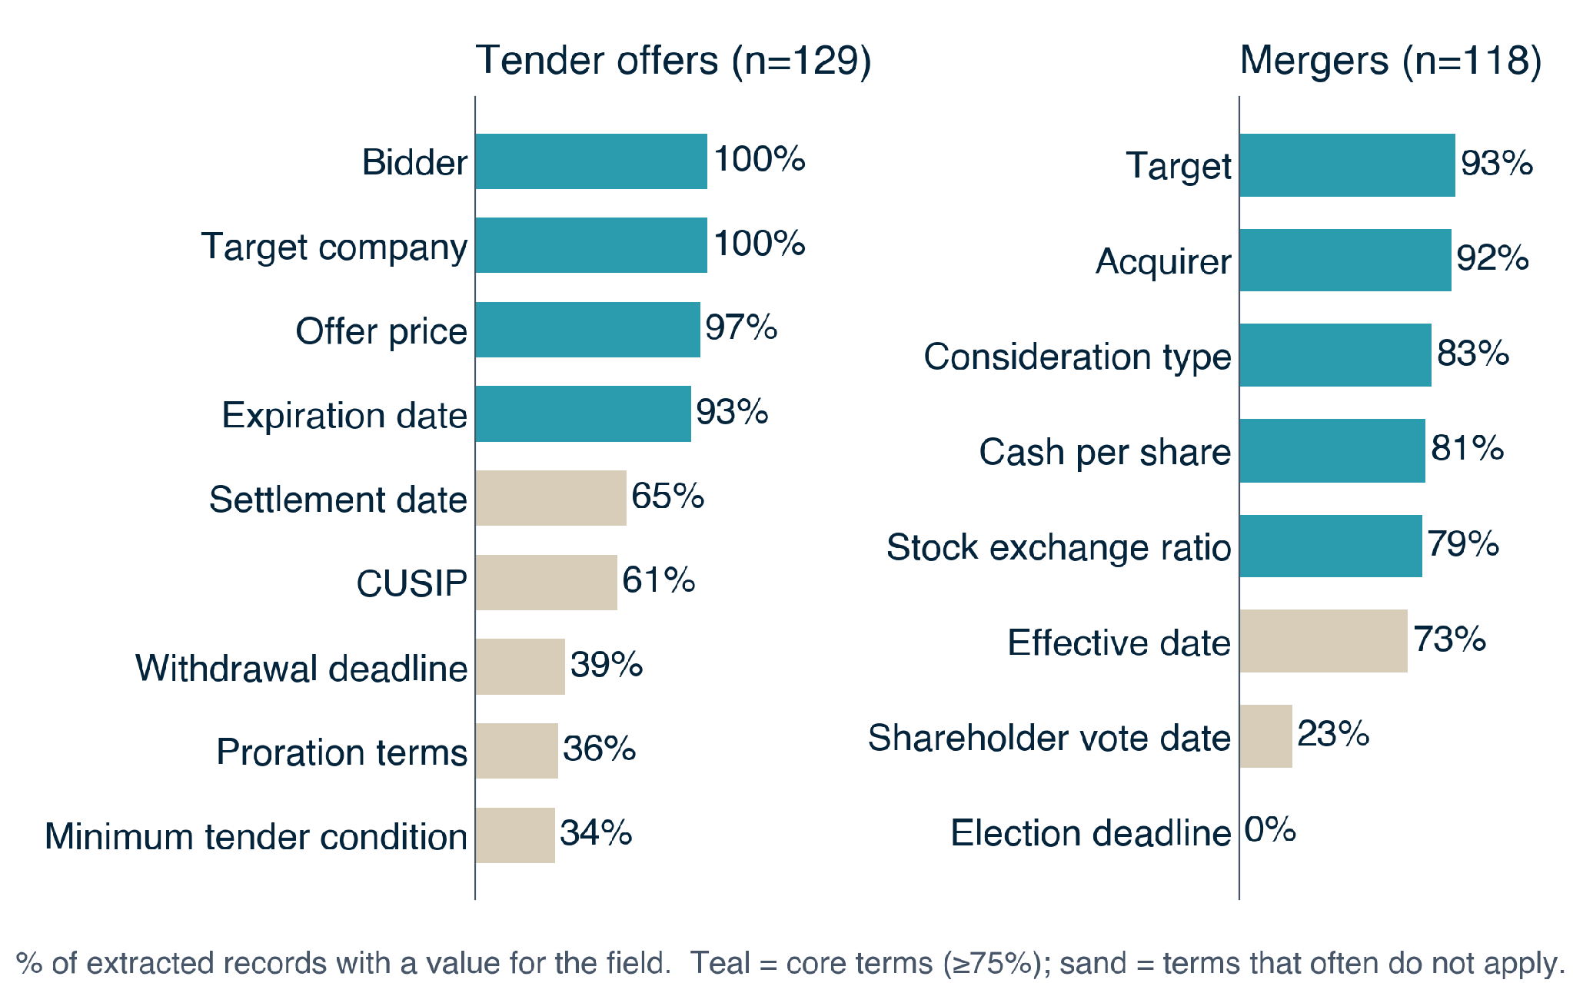
The LLM finds core deal terms in roughly 80–100% of records
What this shows
79–100%
core terms filled: parties, price, dates
Low ≠ failure
many terms do not apply to every deal
Found ≠ correct
human review comes next
Notes:
TIME: ~45 sec
GOAL: Share early results honestly.
SAY:
• "This is the share of records where the LLM found a value, for tender offers and mergers."
• Teal bars, the core terms (parties, price, expiration date), are filled in roughly 80 to 100 percent of records.
• Sand bars are low, but low isn't failure: many terms don't apply to every deal. Election deadlines only exist when holders get a choice, and only 2 of our merger records offered one.
• "Found isn't the same as correct. Human review is what measures accuracy, and that's next."
CAREFUL: Don't call these accuracy numbers. They are coverage.
HAND OFF: "Let's show you what this looks like in practice." Switch to the demo.

Slide 20

EVALUATION METHODOLOGY
Validation & Observability Framework
Human–Like Verification Approach
Evaluates extracted corporate action fields by leveraging LLMs to inspect the source document retrospectively, mimicking human domain audit rigor.
Mimics Expert Verification
Contextual Grounding Check
Replicates how domain experts verify structured facts against raw source text.
Confirms extracted values are explicitly supported by filing context.
Stream 1 · Baseline Benchmark (Pre-Deployment)
PIPELINE TESTING & ACCURACY BASELINING
STAGE 01
STAGE 02
STAGE 03
LLM GT Extraction
Run Pipeline
Benchmark Accuracy
LLM extracts golden facts from 1,000 reference corporate action filings.
Execute extraction pipeline against the identical 1,000-document set.
Compare pipeline outputs against LLM ground truth to score baseline performance.
Stream 2 · Continuous Observability (Post-Deployment)
CONTINUOUS PRODUCTION SAMPLING
STEP 01
STEP 02
STEP 03
Production Sampling
Backward LLM Search
Grounding & Drift Audit
Continuously sample subsets of live pipeline extractions across active filing streams.
Inspect raw filing text retrospectively to verify extracted facts against the source.
Detect hallucinations, verify grounding scores, and flag live production drift.
Notes:
Kedar
One challenge is that there is not a reliable labeled ground-truth dataset for all of the corporate actions we are working with.
We are therefore creating a standardized reference dataset from historical SEC filings.
We use the same schema and prompt across filings, run them through an LLM, normalize the outputs, and retain the supporting source passages.
Ambiguous examples can then be manually reviewed.
This gives us a scalable benchmark for measuring extraction accuracy, completeness, grounding, and amendment handling. 10_16 BNY Client Demo

Slide 21
From 17,000+ SEC search hits to 561 evidence-backed records
Mergers
17,316
2,144
100
71
118
search hits
filings retrieved
sampled
extracted
records
capped at 500 per form
Tender offers
507
507
613
Same loader and prompts for every corporate-action type
sampled
extracted
records
Notes:
We search the SEC full-text system by form, keyword and filing date. Search hits are documents, not deals, so we sample across forms and keep the full text, including exhibits. Tender filings are much shorter, so almost all extracted on the first try.

Slide 22
Templates

Slide 23
Section Title
Optional one-line description of this section
Notes:
SECTION DIVIDER: use between topics or before the Appendix.

Slide 24
Title and Bullet Points
First key point goes here, kept to one or two lines
Second key point with a supporting detail
Third key point with a supporting detail
Fourth key point with a supporting detail
Image, chart, or diagram
Notes:
TITLE + BULLETS: simple text slide with a visual card on the right.

Slide 25
Three Key Points with Goal and Steps
Key Point One
Key Point Two
Key Point Three
One or two sentences explaining this point in plain language.
One or two sentences explaining this point in plain language.
One or two sentences explaining this point in plain language.
Optional category line: Item • Item • Item • Item • Item
GOAL: State the single goal of this project in one sentence.
01
02
03
04
Step One
Step Two
Step Three
Step Four
Notes:
THREE CARDS: problem statement style. Bottom row = 4 numbered steps.

Slide 26
Process Flow: Eight Steps
01
02
03
04
Step Name
Step Name
Step Name
Step Name
Short description of what happens in this step.
Short description of what happens in this step.
Short description of what happens in this step.
Short description of what happens in this step.
05
06
07
08
Step Name
Step Name
Step Name
Step Name
Short description of what happens in this step.
Short description of what happens in this step.
Short description of what happens in this step.
Short description of what happens in this step.
Notes:
PIPELINE: 8 numbered steps in two rows. Delete steps you do not need.

Slide 27
Screenshot or Demo Slide
Paste screenshot, demo, or full-width image here
Notes:
DEMO: delete the placeholder box and paste a screenshot in its place.

Slide 28
Approach and Rationale
GOAL: Describe what this approach is meant to achieve.
Approach
01
02
03
04
05
Step Name
Step Name
Step Name
Step Name
Step Name
Short description.
Short description.
Short description.
Short description.
Short description.
Why
Reason One
Reason Two
Two sentences explaining the benefit or rationale behind the approach.
Two sentences explaining the benefit or rationale behind the approach.
Notes:
APPROACH + WHY: five horizontal steps on top, two rationale cards below.

Slide 29
Two-Column Comparison
Left Column Heading
Right Column Heading
Opening sentence that frames this column in plain language.
Opening sentence that frames this column in plain language.
Supporting point one
Supporting point two
Supporting point three
Supporting point one
Supporting point two
Supporting point three
Notes:
TWO COLUMNS: methodology, before/after, pros/cons, etc.

Slide 30
Two-Stream Workflow
Stream 1 · Name (Phase)
STAGE 01
STAGE 02
STAGE 03
Stage Name
Stage Name
Stage Name
One-sentence description.
One-sentence description.
One-sentence description.
Stream 2 · Name (Phase)
STAGE 01
STAGE 02
STAGE 03
Stage Name
Stage Name
Stage Name
One-sentence description.
One-sentence description.
One-sentence description.
Notes:
SWIMLANES: two labeled streams, three stages each.

Slide 31
Five Columns with Takeaway Banner
STEP 1
STEP 2
STEP 3
STEP 4
STEP 5
LABEL
LABEL
LABEL
LABEL
LABEL
Column Title
Column Title
Column Title
Column Title
Column Title
Short description of this step in plain language.
Short description of this step in plain language.
Short description of this step in plain language.
Short description of this step in plain language.
Short description of this step in plain language.
“One-sentence takeaway or memorable quote goes here.”
Notes:
STEP COLUMNS: five tinted headers, then a navy takeaway banner.

Slide 32
Key Numbers
00%
00%
00%
00%
Metric label
Metric label
Metric label
Metric label
Short context line
Short context line
Short context line
Short context line
TAKEAWAY: One sentence explaining what these numbers mean.
Notes:
STATS: big numbers with short labels. Keep to 3 or 4.

Slide 33
Table Slide
Column A | Column B | Column C | Status
Row label | Value | Value | Status
Row label | Value | Value | Status
Row label | Value | Value | Status
Row label | Value | Value | Status
Row label | Value | Value | Status
Row label | Value | Value | Status
Notes:
TABLE: edit cells directly; add rows by copying a row in PowerPoint.

Slide 34
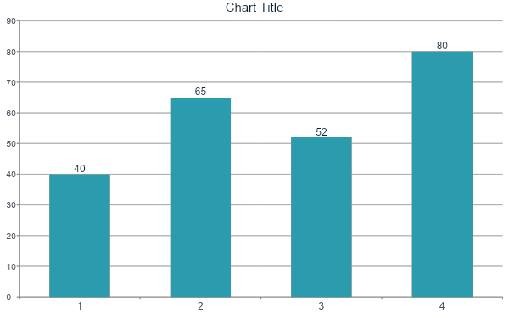
Chart with Commentary
Key Takeaways
First takeaway from the chart
Second takeaway from the chart
Third takeaway from the chart
Notes:
CHART: right-click the chart and choose Edit Data to change the numbers.

Slide 35
Questions and Discussion Points
01
Question or discussion point goes here, written as one clear sentence?
02
Question or discussion point goes here, written as one clear sentence?
03
Question or discussion point goes here, written as one clear sentence?
04
Question or discussion point goes here, written as one clear sentence?
05
Question or discussion point goes here, written as one clear sentence?
Notes:
DISCUSSION LIST: numbered rows, up to five.

Slide 36
Questions?
We'd love to hear your feedback and answer any questions.
Thank you for your time and continued support.
Corporate Action Intelligence Team
Aesha Gandhi, Pranshul Bhatnagar, Alex Li, Kedar Vaidya, Aaron Jiang
Notes:
CLOSING SLIDE: replace the team and presenter names.

Slide 37
CORPORATE ACTION INTELLIGENCE
Problem Statement & Solution Architecture
Large & Complex Documents
Relevant information is spread across lengthy filings, footnotes, and supporting exhibits.
Terms Change Over Time
Amendments dynamically revise transaction prices, key dates, and execution conditions.
Values Need Context
Key numerical values must be linked to the correct event, field, and verified source.
Covered Event Types: Mergers • Tender Offers • Exchange Offers • Rights Issues • Conversions
GOAL: Build a structured corporate-action dataset with traceable evidence for review and downstream automated processing.
input 01
Intake & Classification
timeline 02
Temporal Event Tracking
settings 03
Downstream Processing
verified_user 04
Audit & Exceptions
Notes:
Aesha
The core problem is that corporate-action information is often buried across long SEC filings, footnotes, and exhibits, so the important terms are not immediately accessible.
A second challenge is that the event changes over time. A later amendment may revise the offer price, expiration date, or other key conditions, so looking at one filing in isolation is not enough.
The third challenge is context: a number by itself is not useful unless we know what field it belongs to, which event it applies to, and where it came from.
So our goal is not just to extract values, but to build a structured corporate-action dataset where each field is tied back to traceable source evidence.
We are designing the framework to support several event types, but for the current demo and implementation work we are narrowing in on tender offers and mergers first.
The workflow at the bottom reflects the broader system: intake and classification, tracking changes over time, enabling downstream processing, and keeping an audit trail for exceptions and review.
Turn unstructured notices and filing documents into standardized, structured event fields.
Link multiple notices to the same event and identify what changed or superseded prior information.
Determine required actions such as calculations, notifications, and settlement-related operational steps.
Log decisions and evidence with full lineage; route ambiguous or high-risk cases to human review.

Slide 38
DATA PREPROCESSING & REASONING ARCHITECTURE
End-to-End Event Pipeline
01
02
03
04
SEC Metadata
Retrieve Filing Bundle
Normalize Documents
Extract Candidate Facts
Initial discovery and indexing via SEC EDGAR
Fetch complete source documents and exhibits from SEC EDGAR.
Convert raw HTML into clean, searchable plain text.
AI layer (GliNER) extracts structured candidate fact payloads.
05
06
07
08
Concise Representation
Reason / Verify / Resolve
Canonical Event State
BNY Client Notification
Compact event representation preserving evidence & context.
Process amendments and resolve canonical facts.
Single source of truth for verified corporate action facts.
Enriched internal context integrated for downstream alerts.
Notes:
Alex
This slide shows the full flow from raw SEC data to something that can actually be used downstream.
First, we use SEC metadata to identify relevant filings and then retrieve the complete filing bundle, including exhibits when needed.
Next, we normalize the documents so the filing text is in a cleaner, searchable format.
From there, we extract candidate facts such as prices, dates, parties, conditions, and other event-specific fields.
The next step is important: we do not treat every extracted value as automatically correct. We preserve evidence and context, then reason across multiple filings and amendments to resolve conflicts and determine the current value.
That gives us a canonical event state — essentially one current source of truth for the corporate action.
Once we have that structured event state, it can support downstream use cases such as internal alerts, client notifications, and other operational workflows.
The main idea is that the technical extraction is only one piece; the value comes from turning multiple documents into one reliable, current event representation.

Slide 39
CORPORATE ACTION INTELLIGENCE
Filings Monitor Demo
Notes:
Pranshul

